Slide 1
Laravel APIS Authentication
Eng.Doaa Mohamed Abd Elfatah

Slide 2
Token
A token is a piece of data which only Server could possibly have created, and which contains enough data to identify a p articular user.
You might present your login information and ask server for token and then you might present your token and ask server to perform some user specific action.
Tokens are created using various combinations of various techniques from the field of cryptography as well as with input from the wider field of security research.

Slide 3
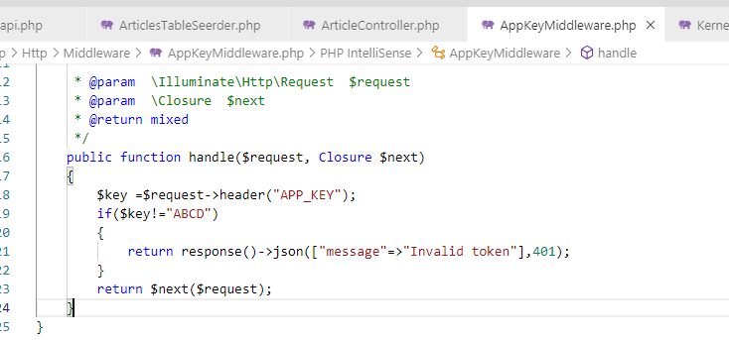
How to Secure your API
First Create a Middleware :

Slide 4
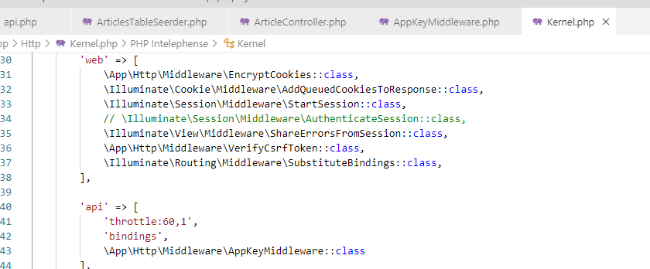
How to Secure your API
Register you Middleware to api array in kernel file

Slide 5
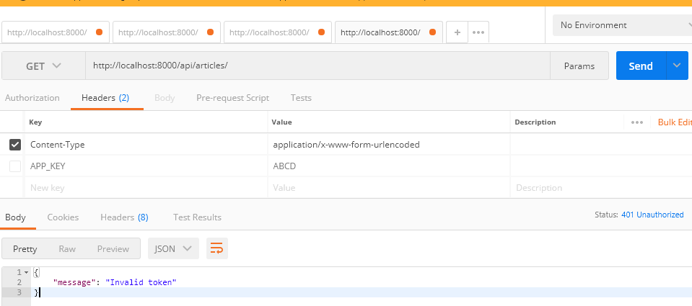
How to Secure your API
Then test it:

Slide 6
How to Secure your API
Then test it:

Slide 7
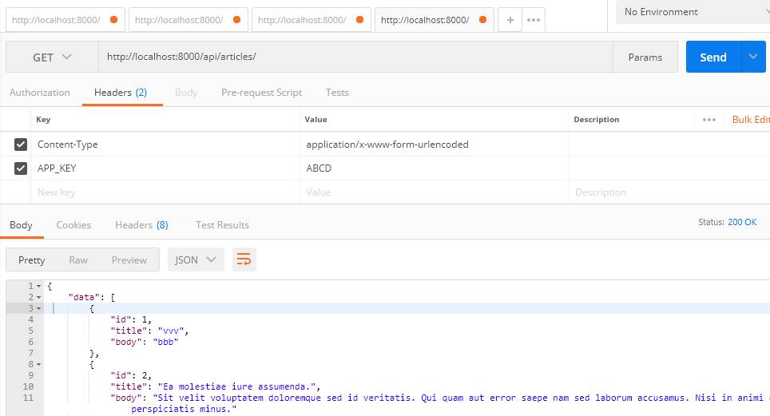

Slide 8
API Authentication with api_token
By default, Laravel ships with a simple solution to API authentication via a random token assigned to each user of your application. In your config/auth.php configuration file, an api guard is already defined and utilizes a token driver. This driver is responsible for inspecting the API token on the incoming request and verifying that it matches the user's assigned token in the database.
Note: While Laravel ships with a simple, token based authentication guard, we strongly recommend you consider using Laravel Passport for robust, production applications that offer API authentication.

Slide 9
Configuration
Database Preparation
Before using the token driver, you will need to create a migration which adds an api_token column to your users table:
Schema::table('users', function ($table) {
$table->string('api_token', 80)->after('password')
->unique()
->nullable()
->default(null);
});
php artisan make:migration alter_users_table
If you choose to use a different column name, be sure to update your API's storage_key configuration option within the config/auth.php configuration file.

Slide 10
Generating Tokens
use Illuminate\Support\Facades\Hash;
use Illuminate\Support\Str;
protected function create(array $data)
{
return User::create([
'name' => $data['name'],
'email' => $data['email'],
'password' => Hash::make($data['password']),
'api_token' => Str::random(80),
]);
}
Once the api_token column has been added to your users table, you are ready to assign random API tokens to each user that registers with your application. You should assign these tokens when a User model is created for the user during registration. When using the authentication scaffolding provided by the laravel/ui Composer package, this may be done in the create method of the RegisterController:
Don’t forget add api_token to $fillable in User model
protected $fillable = [
'name', 'email', 'password','api_token'
];

Slide 11
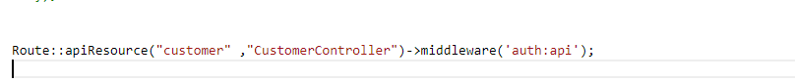
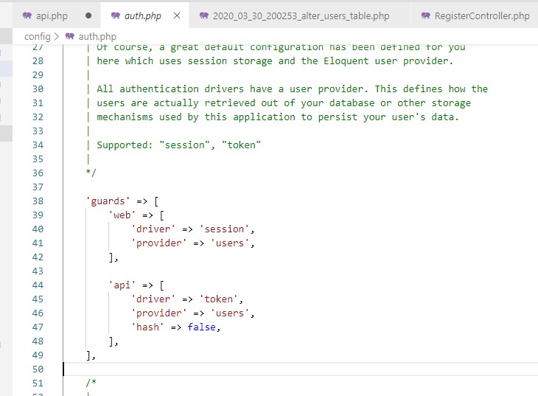
Secure routes

Slide 12
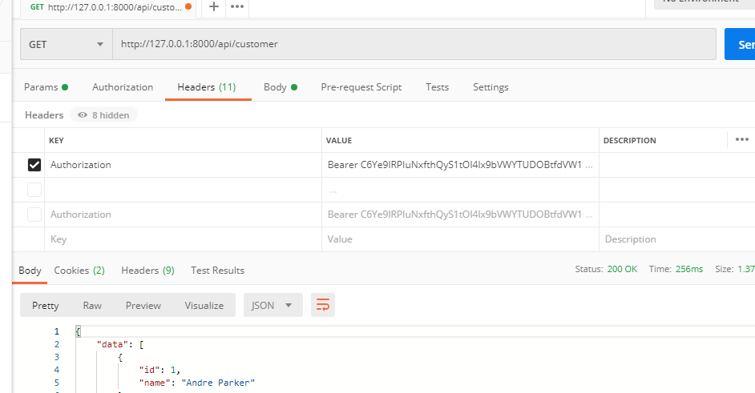
Test API Auth using api_token
To test token get the user api_token from create or login
Then send it with param or header

Slide 13
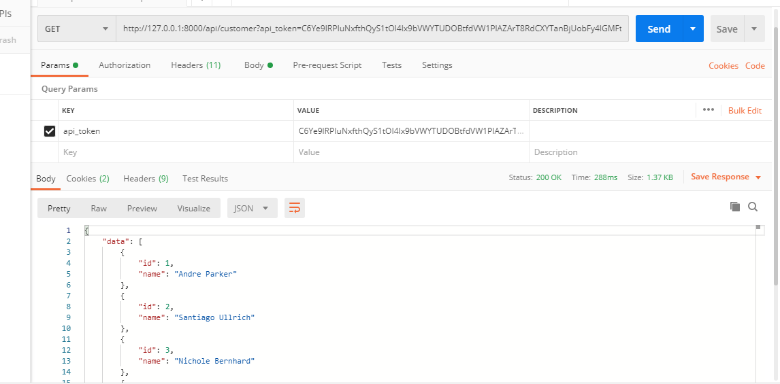

Slide 14
Hashing Tokens
In the examples above, API tokens are stored in your database as plain-text. If you would like to hash your API tokens using SHA-256 hashing, you may set the hash option of your api guard configuration to true. The api guard is defined in your config/auth.php configuration file:
'api' => [
'driver' => 'token',
'provider' => 'users',
'hash' => true,
],

Slide 15
Hashing Tokens
Then make method to get api_token and update it hashed
Route::put('user/token/{user}', "Auth\RegisterController@update");
function update(User $user){
$token = Str::random(80);
$user->forceFill([
'api_token' => hash('sha256', $token),
])->save();
return ['token' => $token];
}

Slide 16
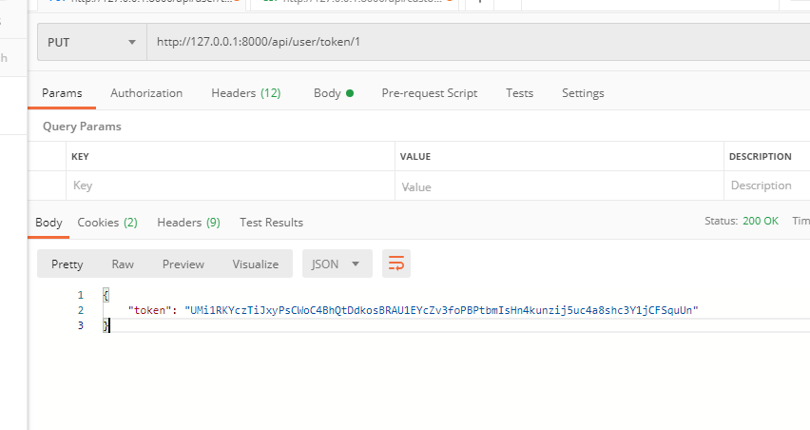
Request the token

Slide 17
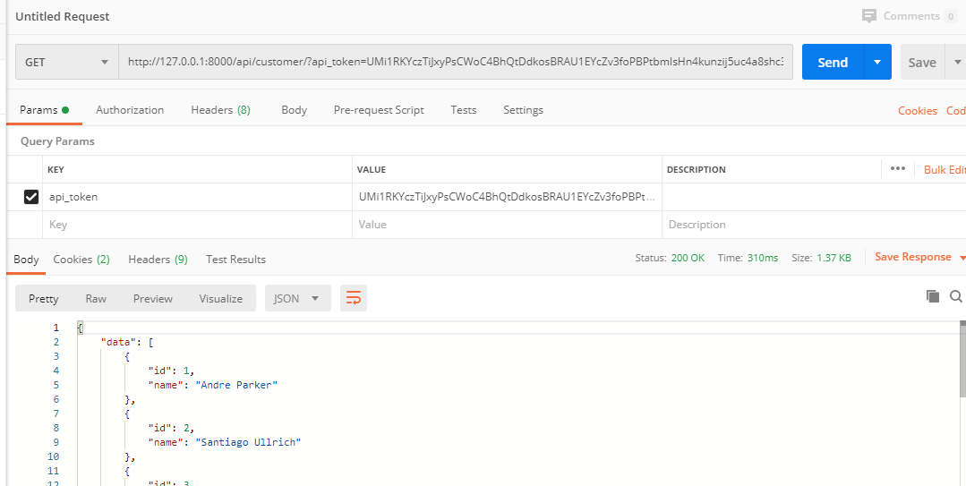
Test secure api by sending api_token

Slide 18
Laravel Passport

Slide 19
Introduction
Laravel already makes it easy to perform authentication via traditional login forms, but what about APIs? APIs typically use tokens to authenticate users and do not maintain session state between requests. Laravel makes API authentication a breeze using Laravel Passport, which provides a full OAuth2 server implementation for your Laravel application in a matter of minutes. Passport is built on top of the League OAuth2 server that is maintained by Andy Millington and Simon Hamp.

Slide 20
OAuth 2.0
OAuth 2.0 is the industry-standard protocol for authorization. OAuth 2.0 focuses on client developer simplicity while providing specific authorization flows for web applications, desktop applications, mobile phones, and living room devices. This specification and its extensions are being developed within the IETF OAuth Working Group.
Roles
The Third-Party Application: "Client"
The client is the application that is attempting to get access to the user's account. It needs to get permission from the user before it can do so.
The API: "Resource Server"
The resource server is the API server used to access the user's information.
The Authorization Server
This is the server that presents the interface where the user approves or denies the request. In smaller implementations, this may be the same server as the API server, but larger scale deployments will often build this as a separate component.
The User: "Resource Owner"
The resource owner is the person who is giving access to some portion of their account

Slide 21
Installation
To get started, install Passport via the Composer package manager:
composer require laravel/passport
The Passport service provider registers its own database migration directory with the framework, so you should migrate your database after installing the package. The Passport migrations will create the tables your application needs to store clients and access tokens:
php artisan migrate

Slide 22
Installation
Next, you should run the passport:install command. This command will create the encryption keys needed to generate secure access tokens. In addition, the command will create "personal access" and "password grant" clients which will be used to generate access tokens:
php artisan passport:install

Slide 23
Installation
<?php
namespace App;
use Illuminate\Foundation\Auth\User as Authenticatable;
use Illuminate\Notifications\Notifiable;
use Laravel\Passport\HasApiTokens;
class User extends Authenticatable
{
use HasApiTokens, Notifiable;
}
After running this command, add the Laravel\Passport\HasApiTokens trait to your App\User model. This trait will provide a few helper methods to your model which allow you to inspect the authenticated user's token and scopes:

Slide 24
Installation
<?php
namespace App\Providers;
use Illuminate\Foundation\Support\Providers\AuthServiceProvider as ServiceProvider;
use Illuminate\Support\Facades\Gate;
use Laravel\Passport\Passport;
class AuthServiceProvider extends ServiceProvider
{
protected $policies = [
'App\Model' => 'App\Policies\ModelPolicy',
];
public function boot()
{
$this->registerPolicies();
Passport::routes();
}
}
Next, you should call the Passport::routes method within the boot method of your AuthServiceProvider. This method will register the routes necessary to issue access tokens and revoke access tokens, clients, and personal access tokens:

Slide 25
Installation
Finally, in your config/auth.php configuration file, you should set the driver option of the api authentication guard to passport. This will instruct your application to use Passport's TokenGuard when authenticating incoming API requests:
'guards' => [
'web' => [
'driver' => 'session',
'provider' => 'users',
],
'api' => [
'driver' => 'passport',
'provider' => 'users',
],
],

Slide 26
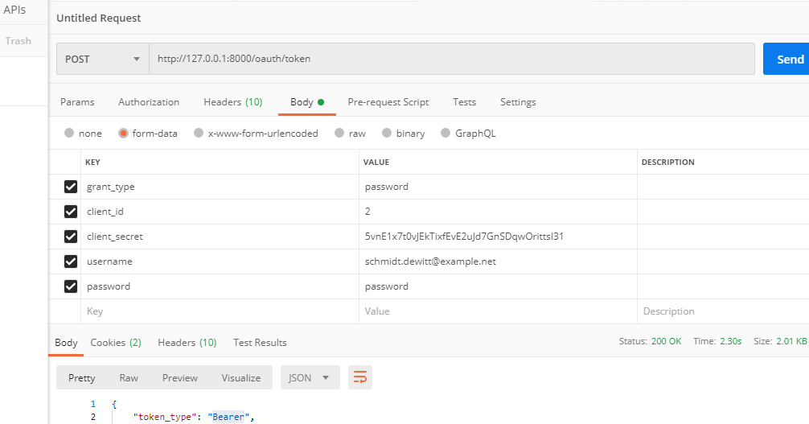
Let’s test it

Slide 27
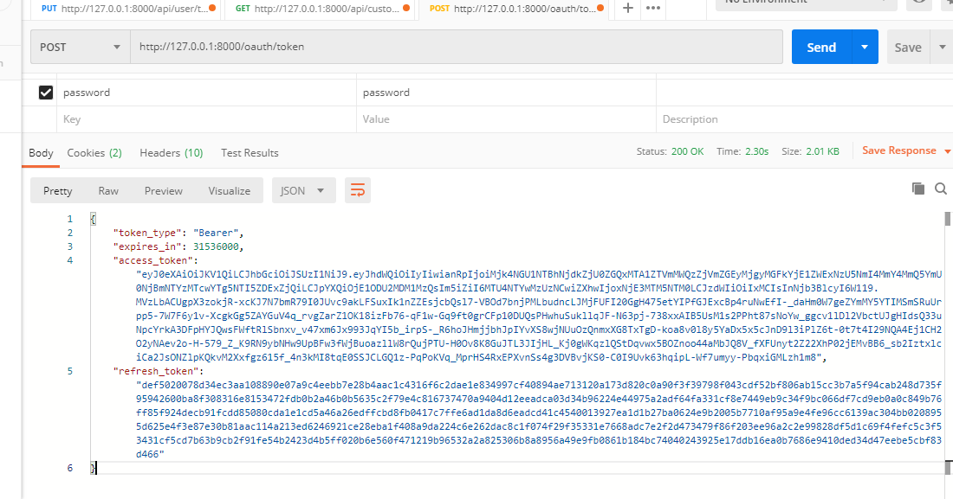

Slide 28
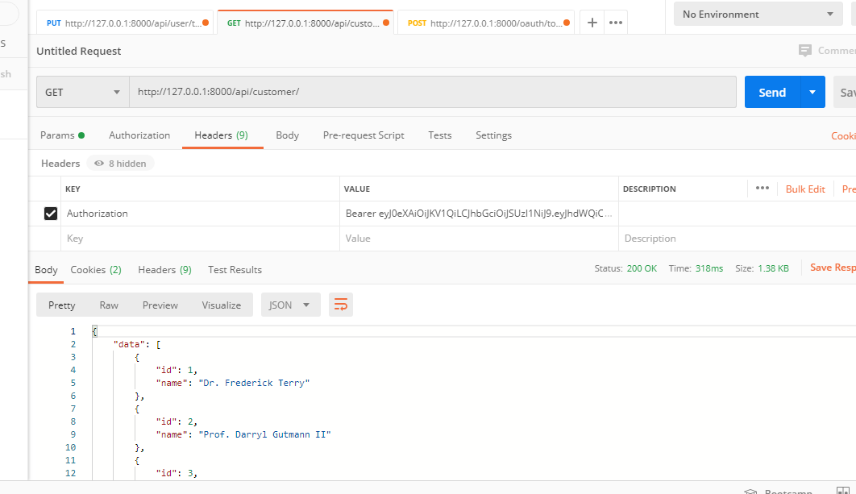

Slide 29
Create API Route
Route::post('login', 'UserController@login');
Route::post('register', 'UserController@register');
Route::group(['middleware' => 'auth:api'], function(){
Route::post('details', 'UserController@details');
});

Slide 30
Create the Controller “UserController ”
public function login(){
if(Auth::attempt(['email' => request('email'), 'password' => request('password')])){
$user = Auth::user();
$success['token'] = $user->createToken(‘app_name')-> accessToken;
return response()->json(['success' => $success], 200);
}
else{
return response()->json(['error'=>'Unauthorised'], 401);
}
}

Slide 31
Create the Controller “UserController ”
public function register(Request $request)
{
$validator = Validator::make($request->all(), [
'name' => 'required',
'email' => 'required|email',
'password' => 'required',
'c_password' => 'required|same:password',
]);
if ($validator->fails()) {
return response()->json(['error'=>$validator->errors()], 401);
}
$input = $request->all();
$input['password'] = bcrypt($input['password']);
$user = User::create($input);
$success['token'] = $user->createToken(‘app_name')-> accessToken;
$success['name'] = $user->name;
return response()->json(['success'=>$success], 200);
}

Slide 32
Create the Controller “UserController ”
public function details()
{
$user = Auth::user();
return response()->json(['success' => $user], 200);
}

Slide 33
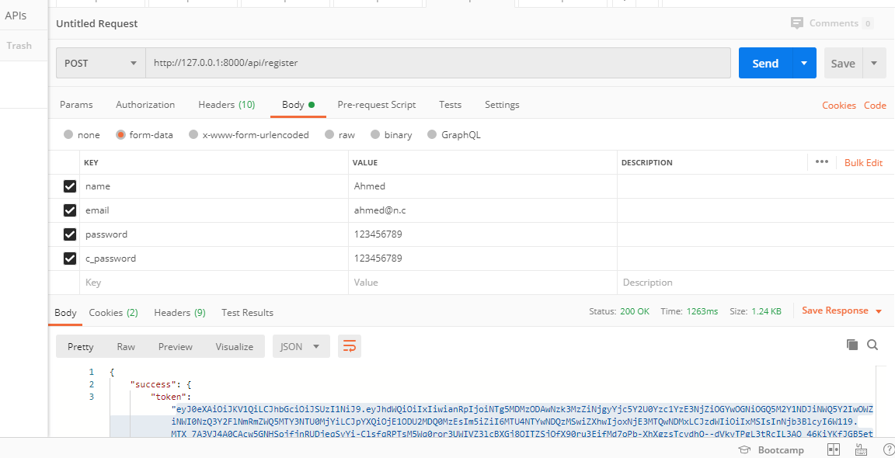

Slide 34
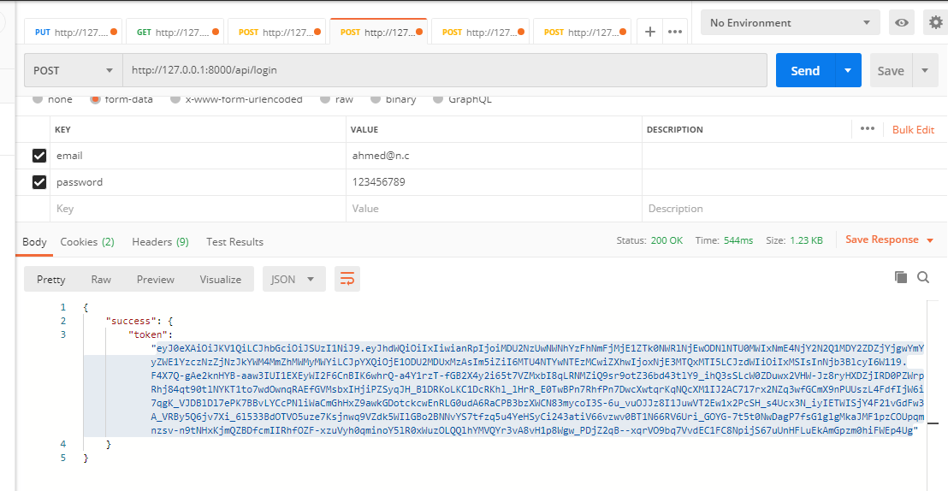

Slide 35
